Slide 1
Partnership Program
Summer 2020

Slide 2
Option One
Option #1:
Pre Sale - Bulk Order Option
Choose clothing options and approve final artwork.
OL will provide product pictures to post on social media and your website. Your camp will offer your customers a specific time frame to complete their purchase.
Send Old Lutheran a bulk order after you close the pre-sale.
Bulk pricing allows your camp to retain your profit margin without having to own stock.
You would be mailed a bulk order and fulfill orders on your own.

Slide 3
Option Two
Bulk Price – Order Fulfillment
Choose your products and approve final artwork and retail pricing.
Products will be available on oldlutheran.com. Your camp will receive a link to your custom gear to post on your website and product pictures to help you promote your gear on social media.
Orders will be printed and fulfilled after two weeks of sales. Your camp must have sold at least 12 garments with the same print for gear to go into production. Our team will send you an update if you are in danger of not making your minimum so you can promote your gear. If minimums are not met orders will be held for another 2-week cycle and then refunded.
Old Lutheran will send your camp a commission check at the end of each month. Your profit will be based on cost/retail price of the items and the quantity sold with the same print.

Slide 4
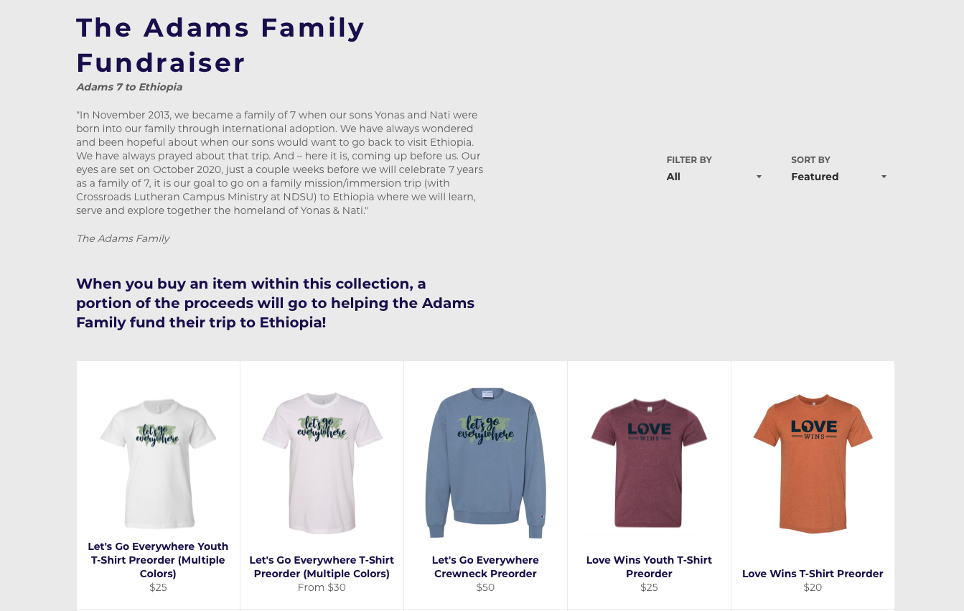
Custom Collection Online (Option 2)
Your Camp Name Here
Your Story or Descriptions Here
Your purchasing process and delivery info here.
Your Gear Here

Slide 5
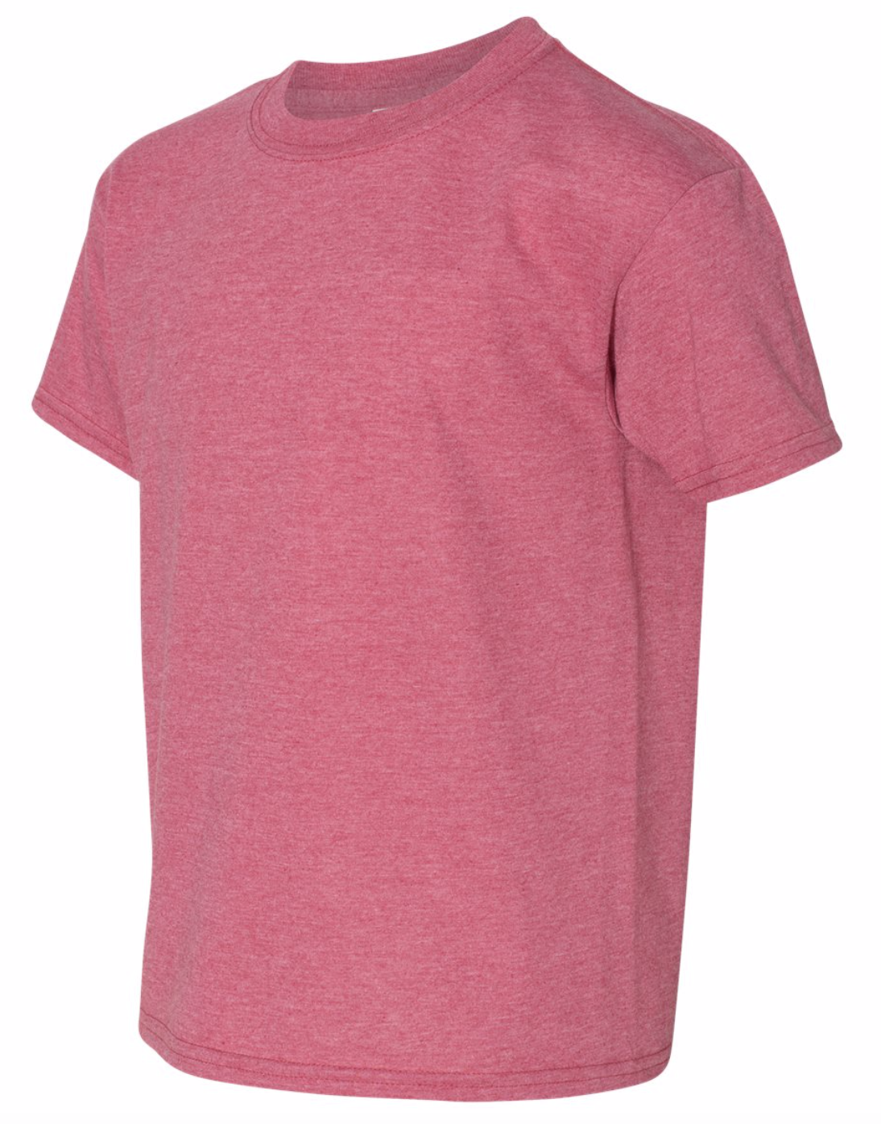
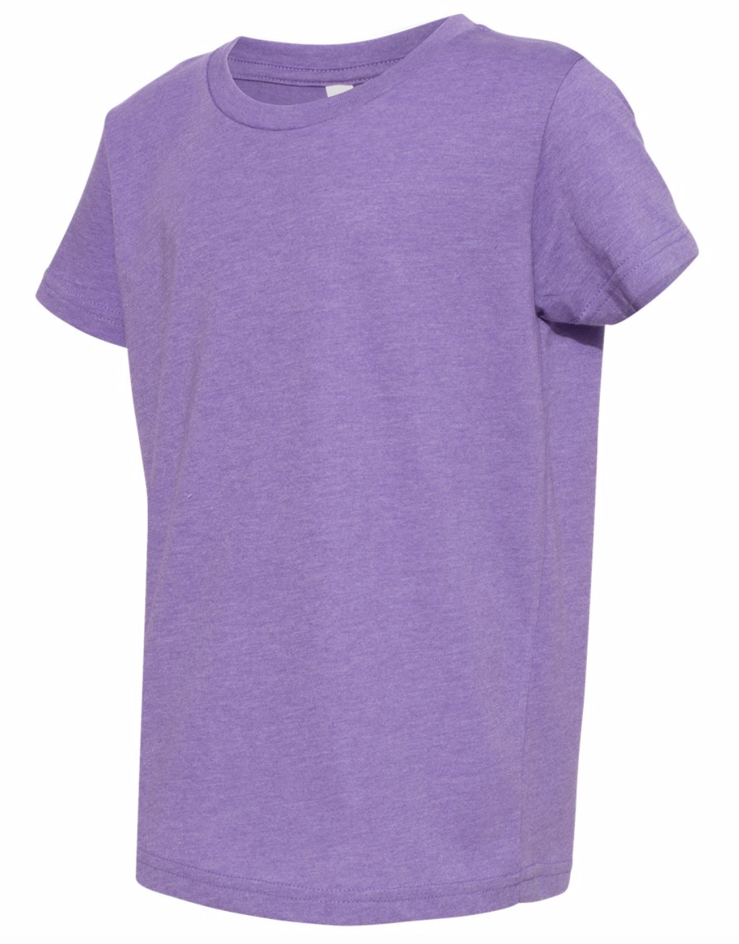
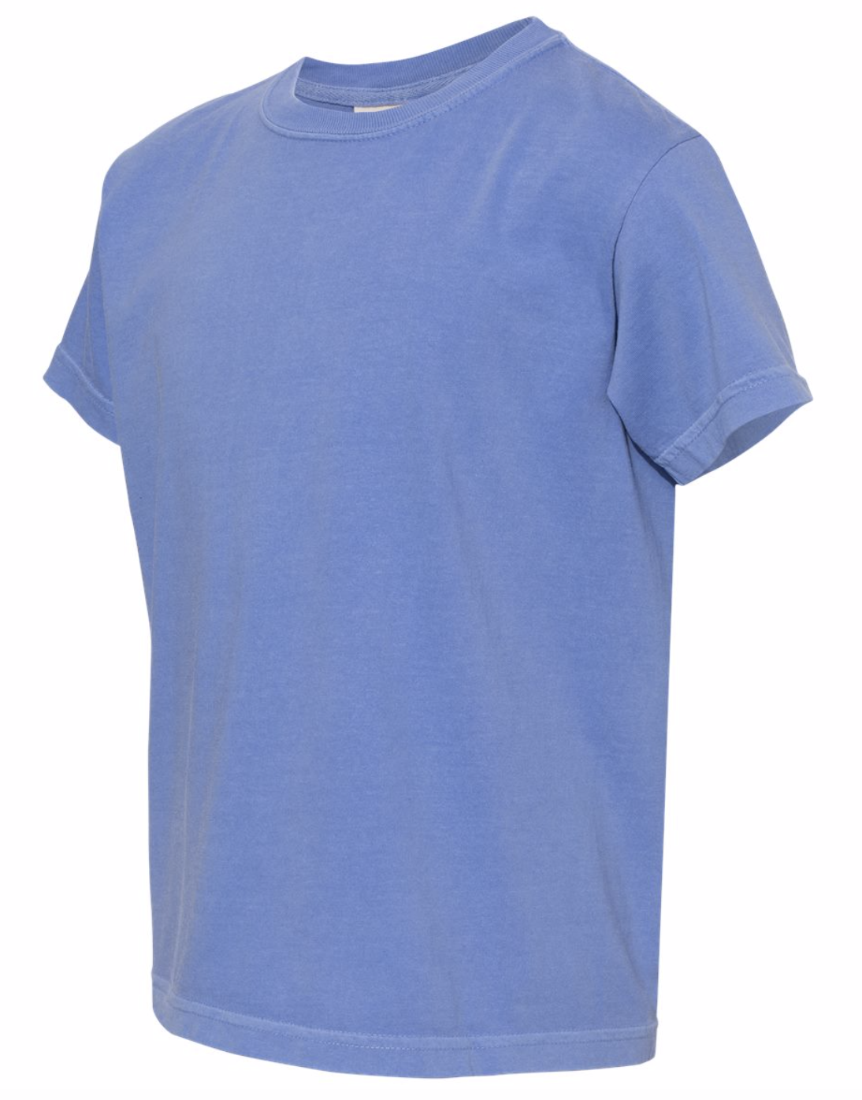
Garment Options: A few Recommendations
Gildan Softstyle https://www.ssactivewear.com/p/gildan/64000
T-shirt
Long sleeve
Sweatshirts
Youth Options
$
Bella Canvas CVC https://www.ssactivewear.com/p/bella/3001cvc
T-shirt
Long Sleeve
Sweatshirts
Youth Option
$$
Comfort Colors https://www.ssactivewear.com/p/comfort_colors/1717
T-shirt
Long sleeve
Sweatshirt
$$
Gildan Softstyle
Bella + Canvas CVC
Comfort Colors

Slide 6
Example Pricing: Cost
200 Garments w/Same Print are Ordered
100 Adult T-shirts (Gildan Softstyle) $6.70/ea
70 Youth T-shirts (Gildan Softstyle) $7.16/ea
30 Adult Crewneck Sweatshirt (Comfort Colors Crewneck) $22.60/ea
Total Garment Cost: $1,848.65
Handling: $2/order

Slide 7
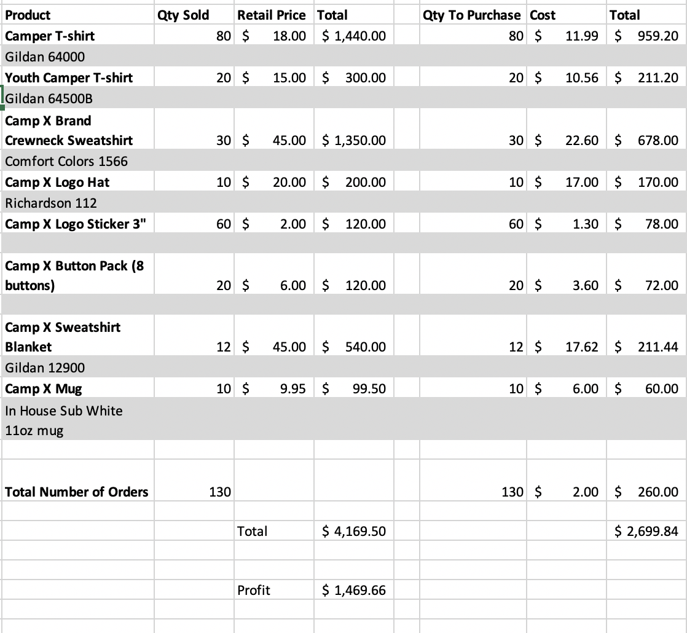
Profit Calculator

Slide 8
Embroidery and Bulk Ordering
Embroidery Process and Cost
Digitizing : $35 for Left chest and Hat logo
This can be paid upfront to allow no minimum order.
Bulk Ordering Products (ie. Water Bottles)
You will pay for product cost upfront.
Receive profit from units sold OL in monthly check
All overstock will be shipped to your designated location after your store closes.

Slide 9
Other Product Options
In House – Individual Orders
Hats (Embroidered)
¼ Zips or Jackets
Mugs
Stickers
Buttons
Magnets
Pans 9” x 13” with Custom Lid
Bulk Orders- Prepaid
Nalgene Water Bottles
Stuffed Animals
Scrunchies
Sunglasses
Floating Key chains
Lanyards
Travel Mugs

Slide 10
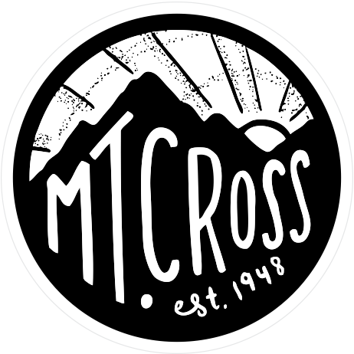
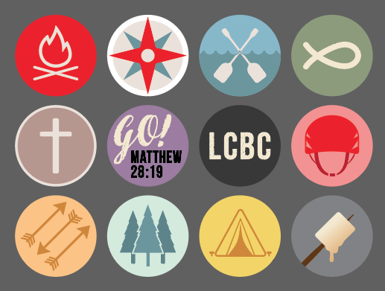
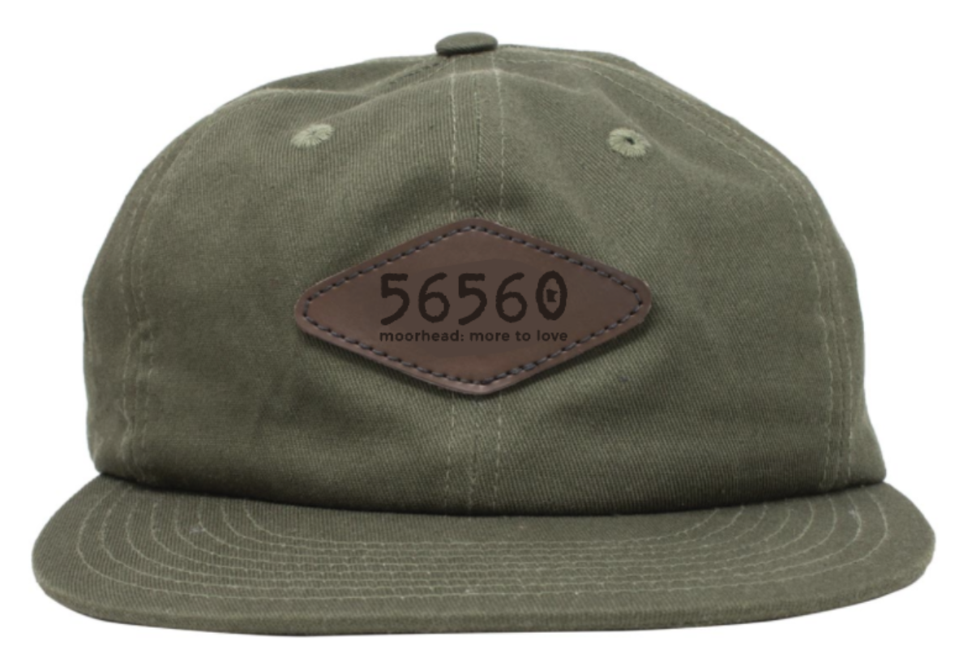
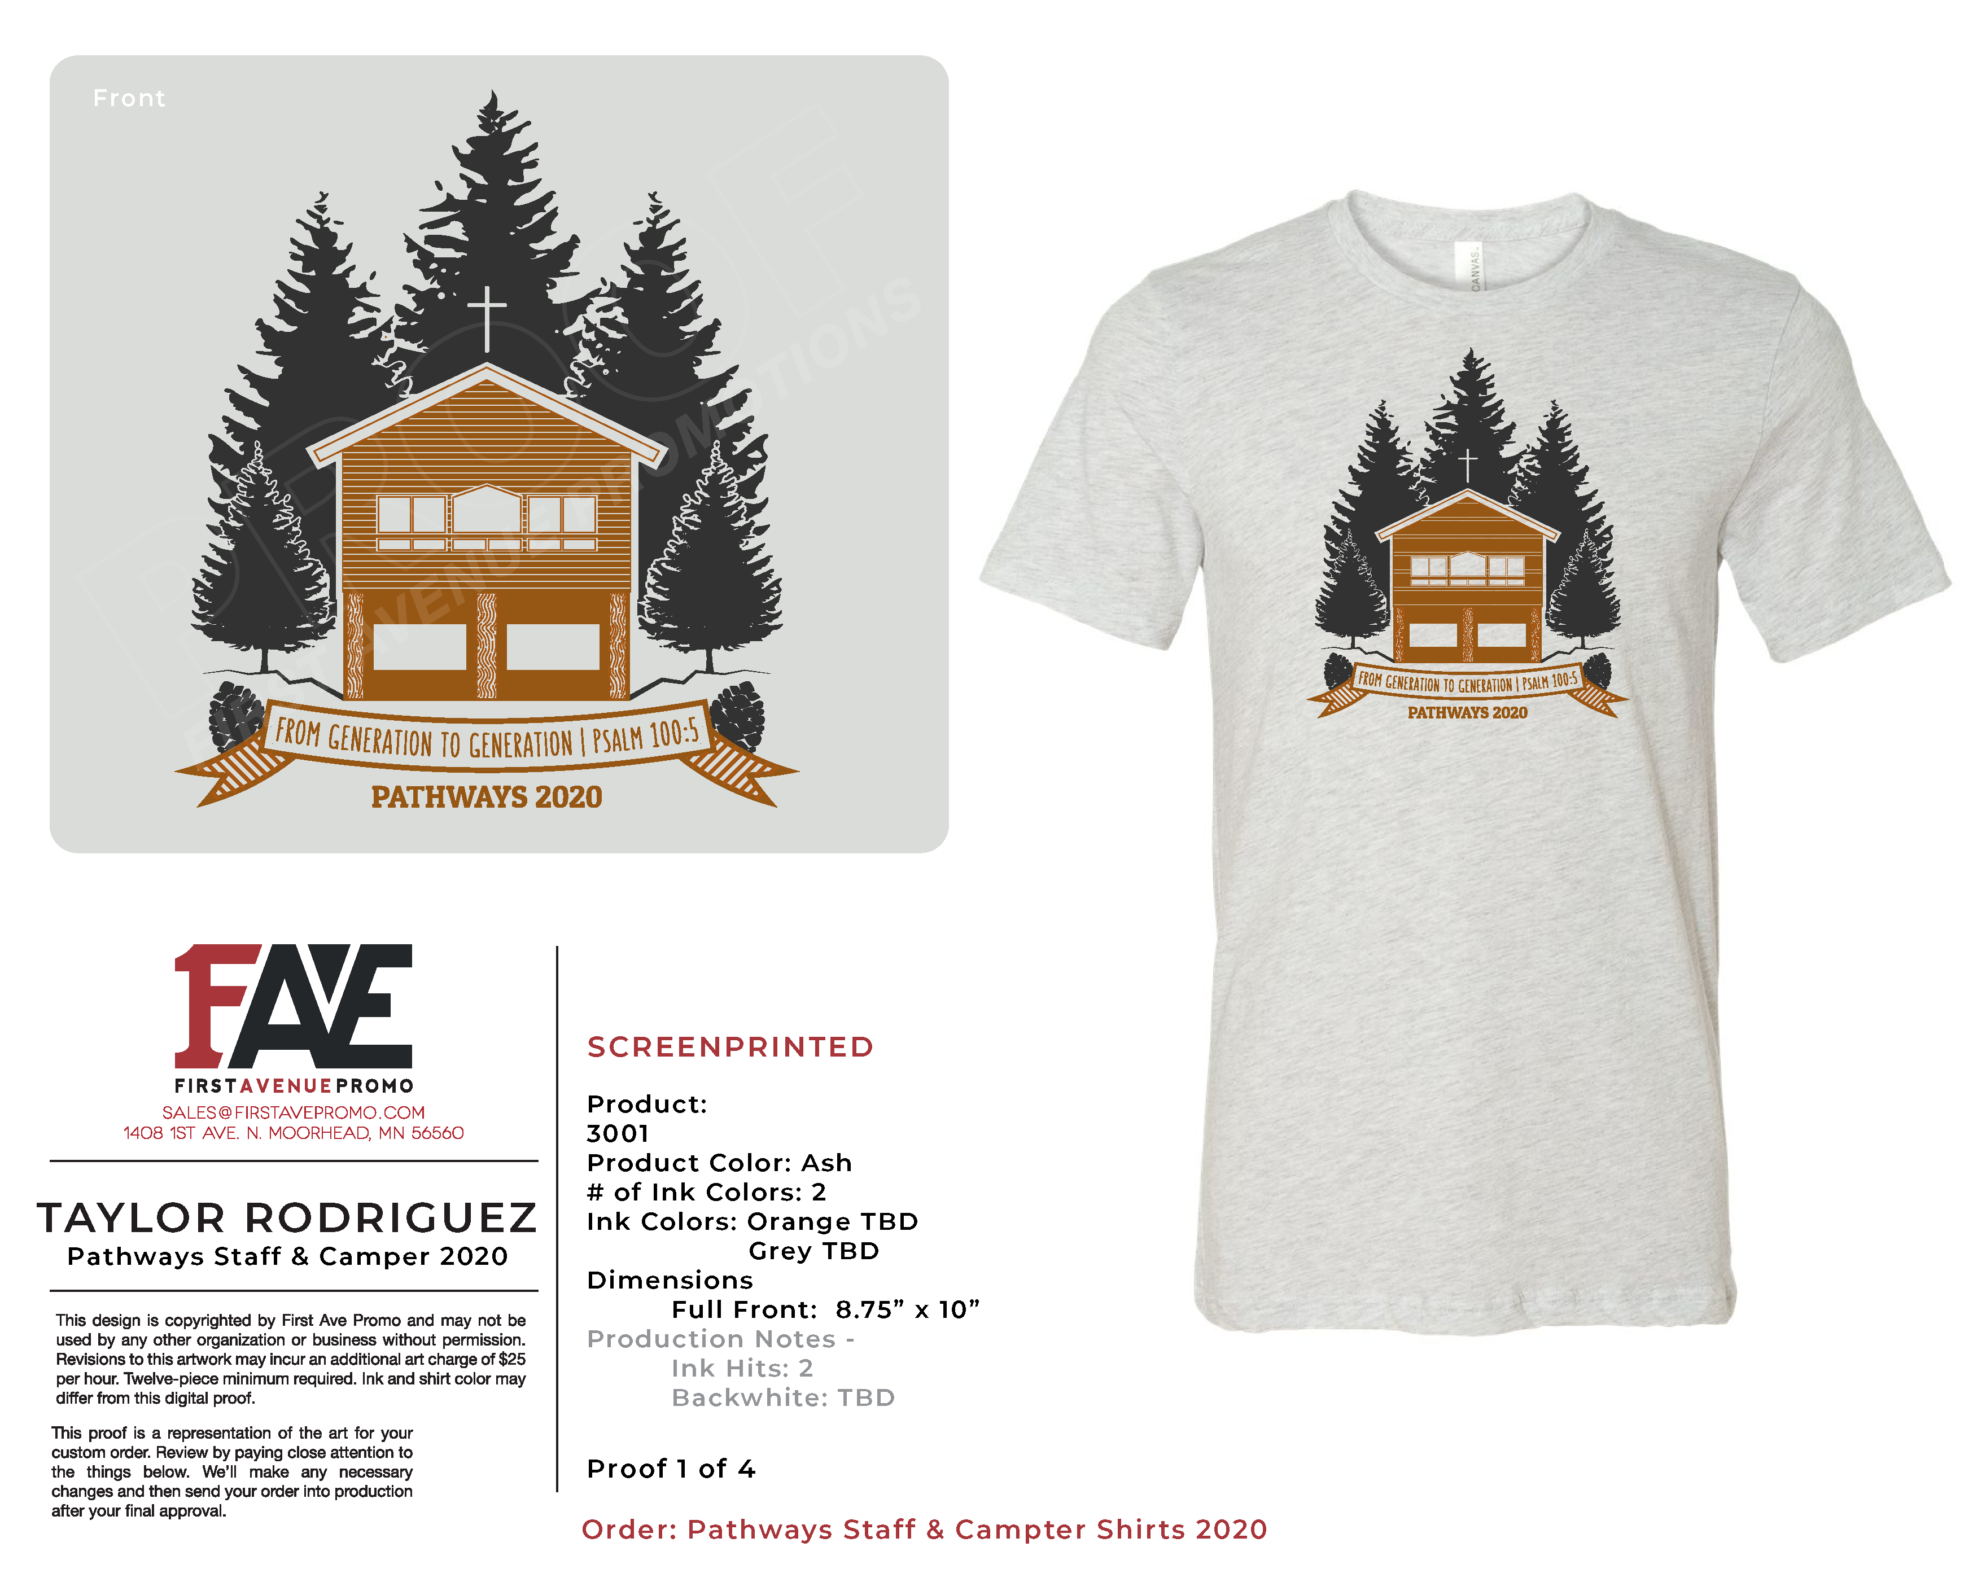
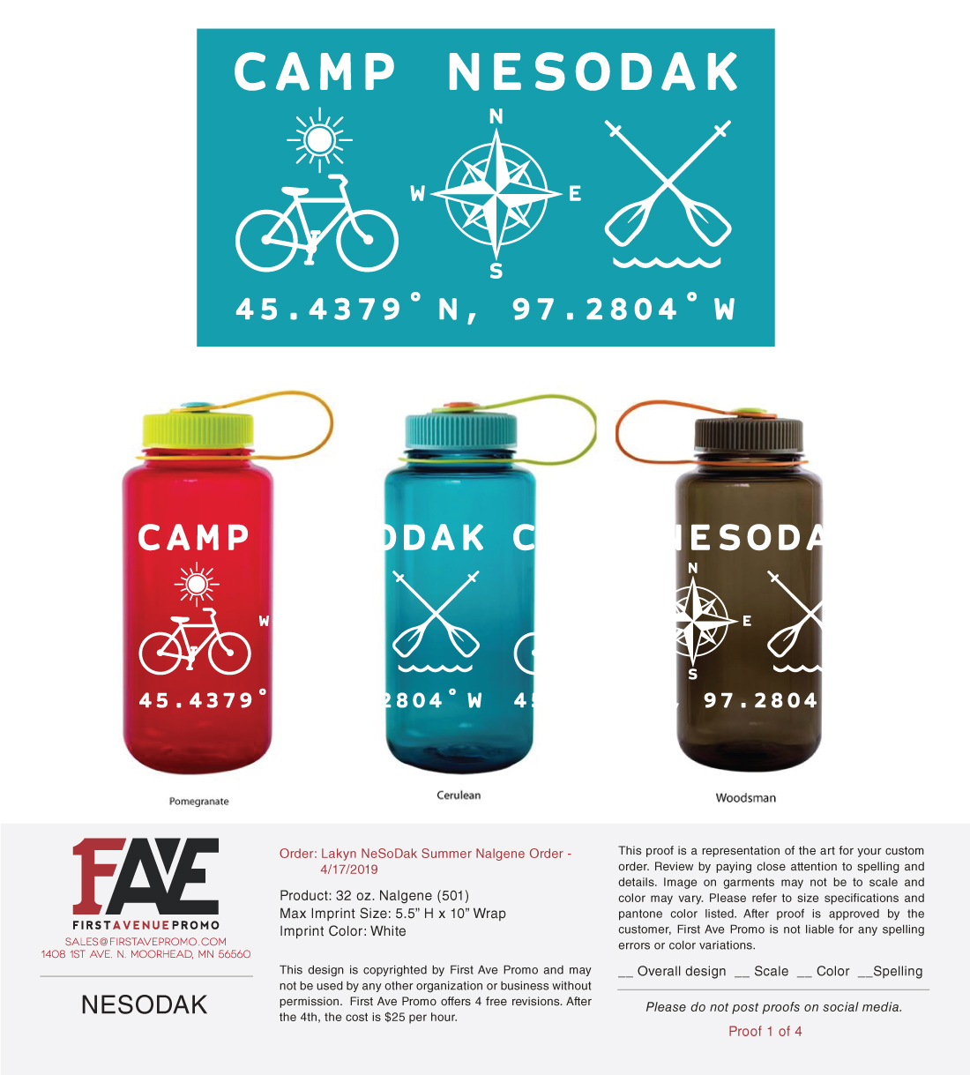
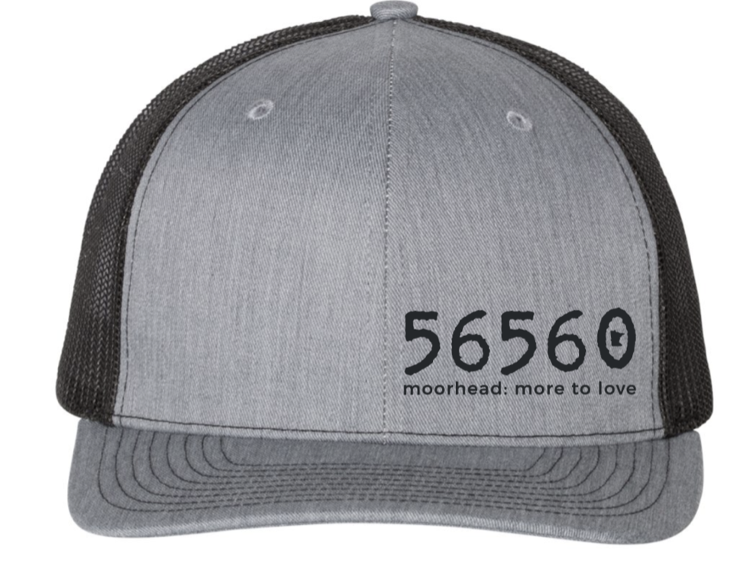
Product Examples

Slide 11
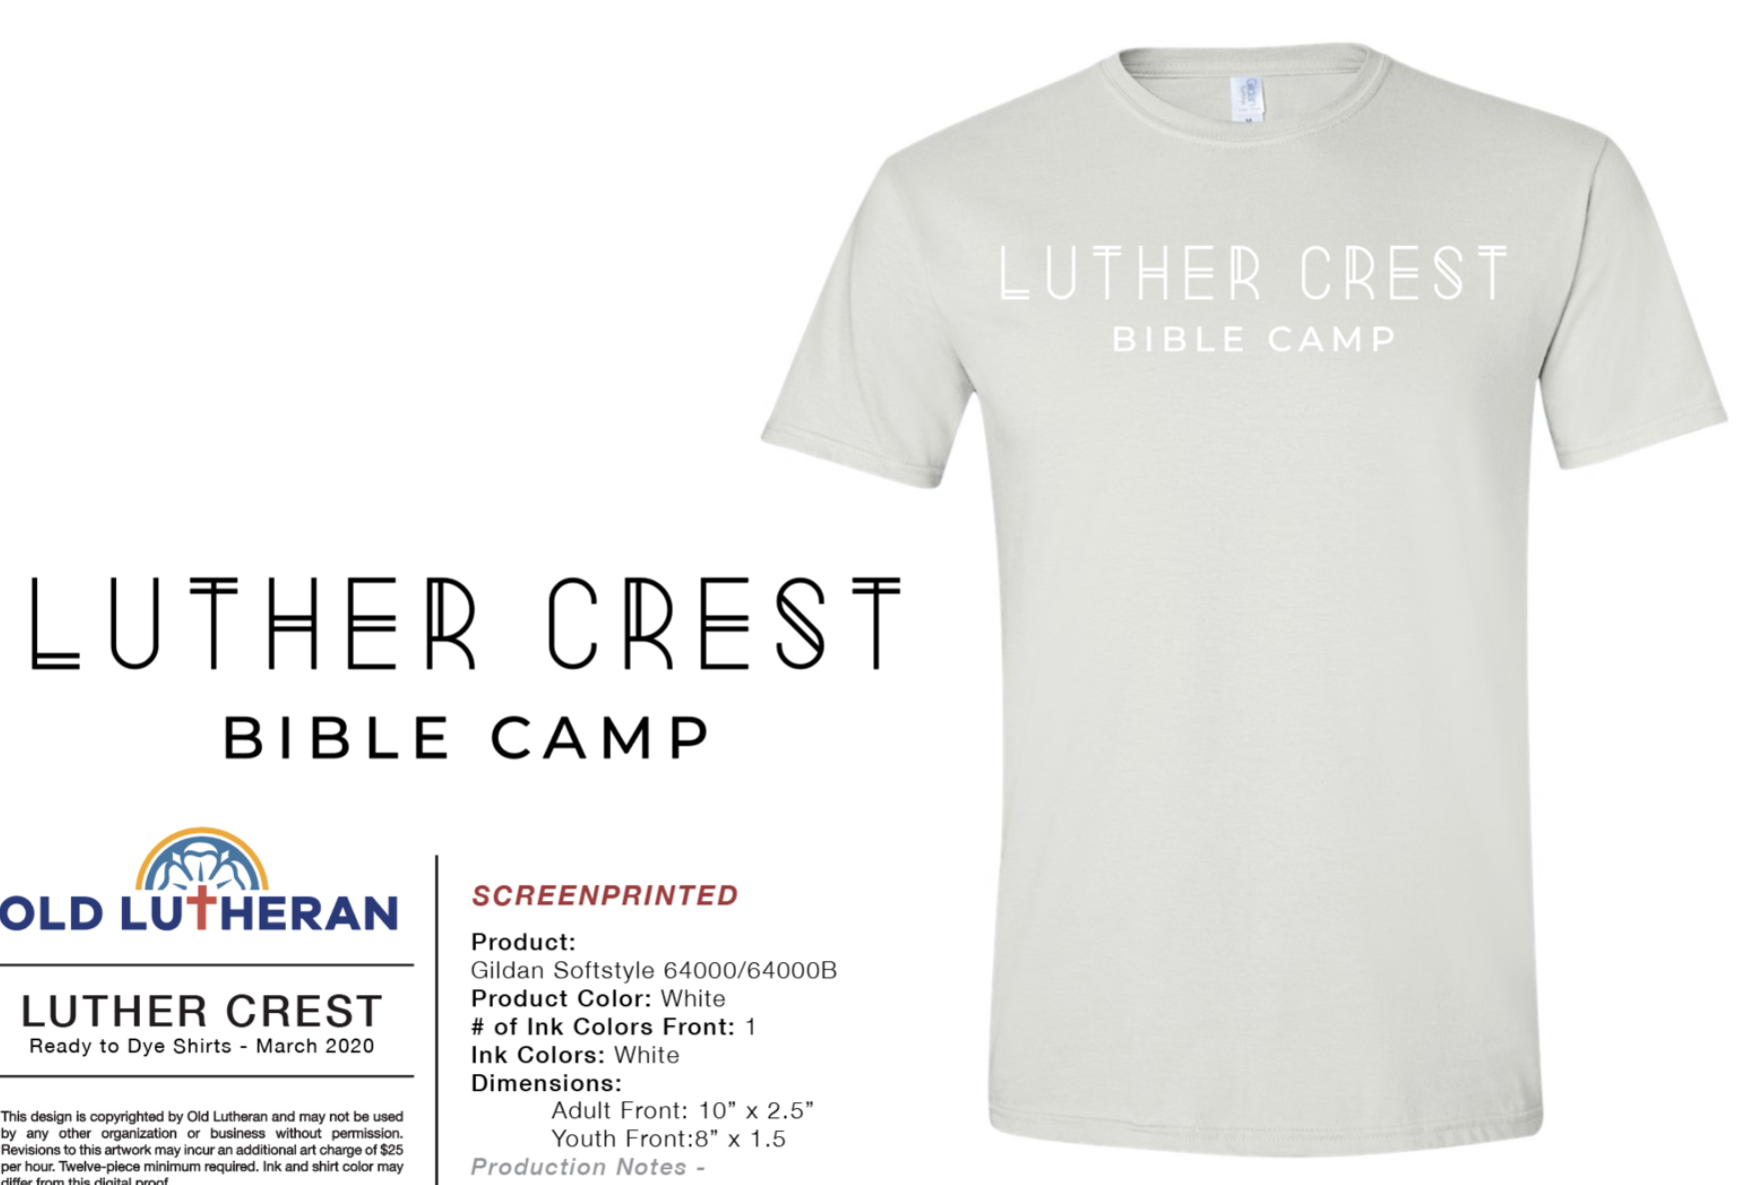
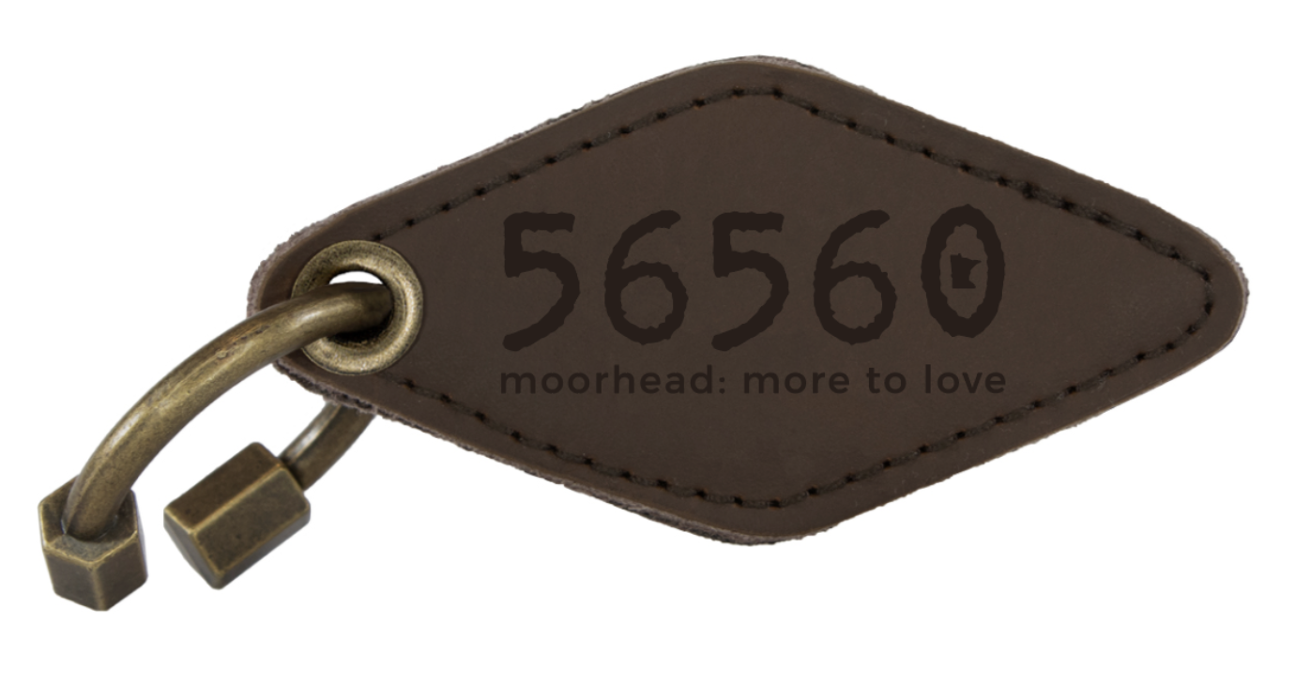
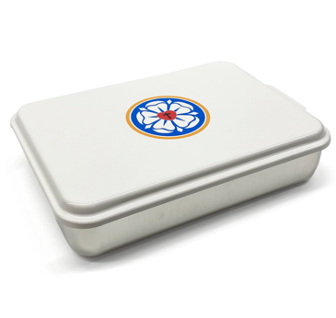
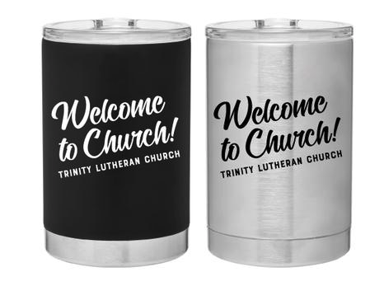
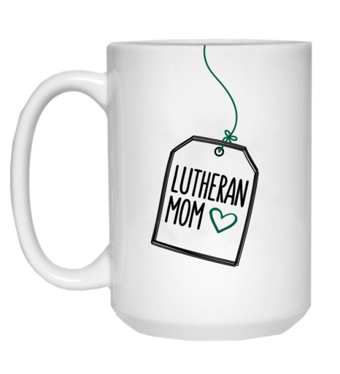
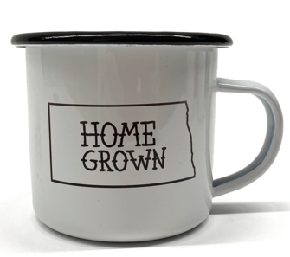
Product Examples

Slide 12
Contact Info
annie@firstavepromo.com
David@oldlutheran.com

